Slide 1

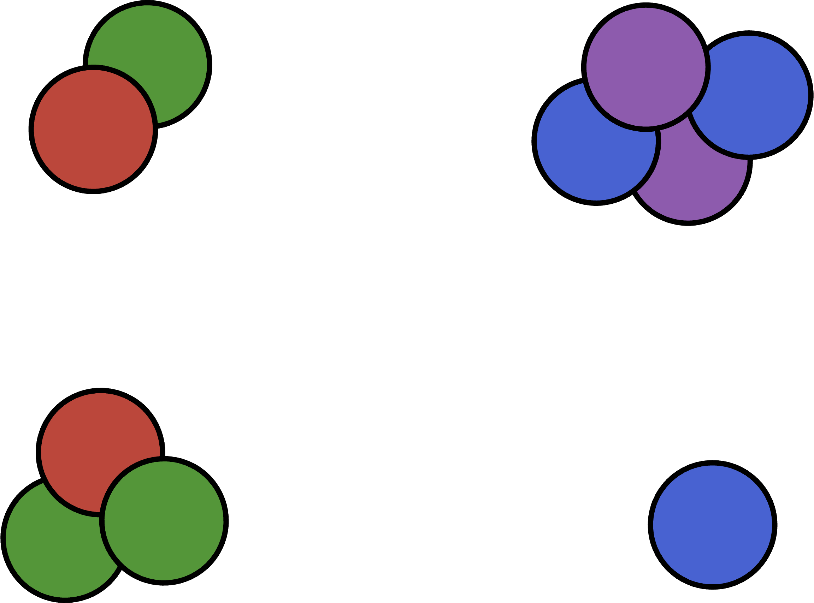

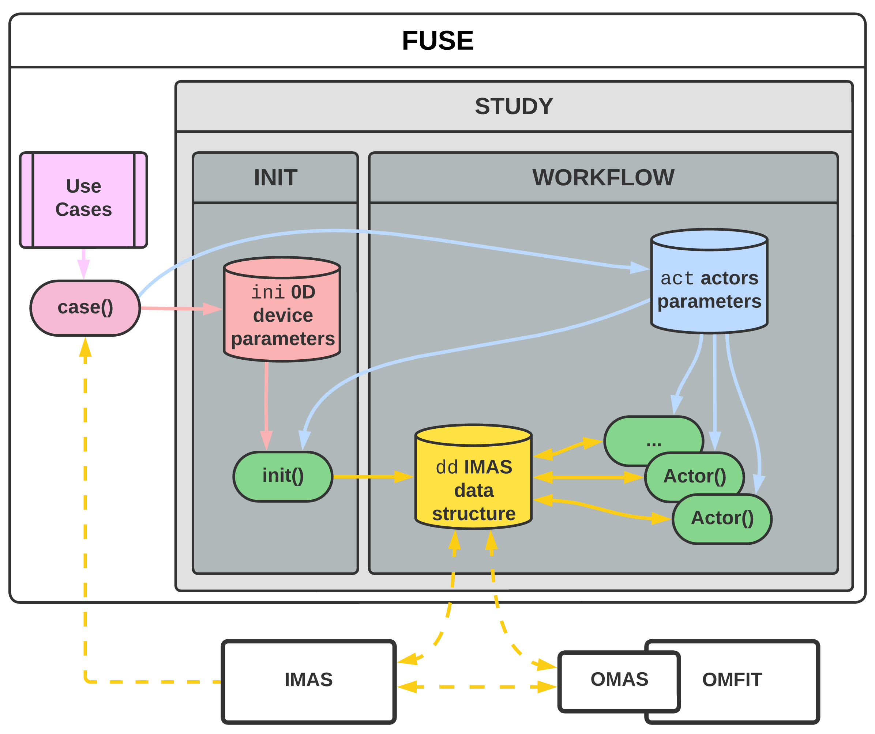
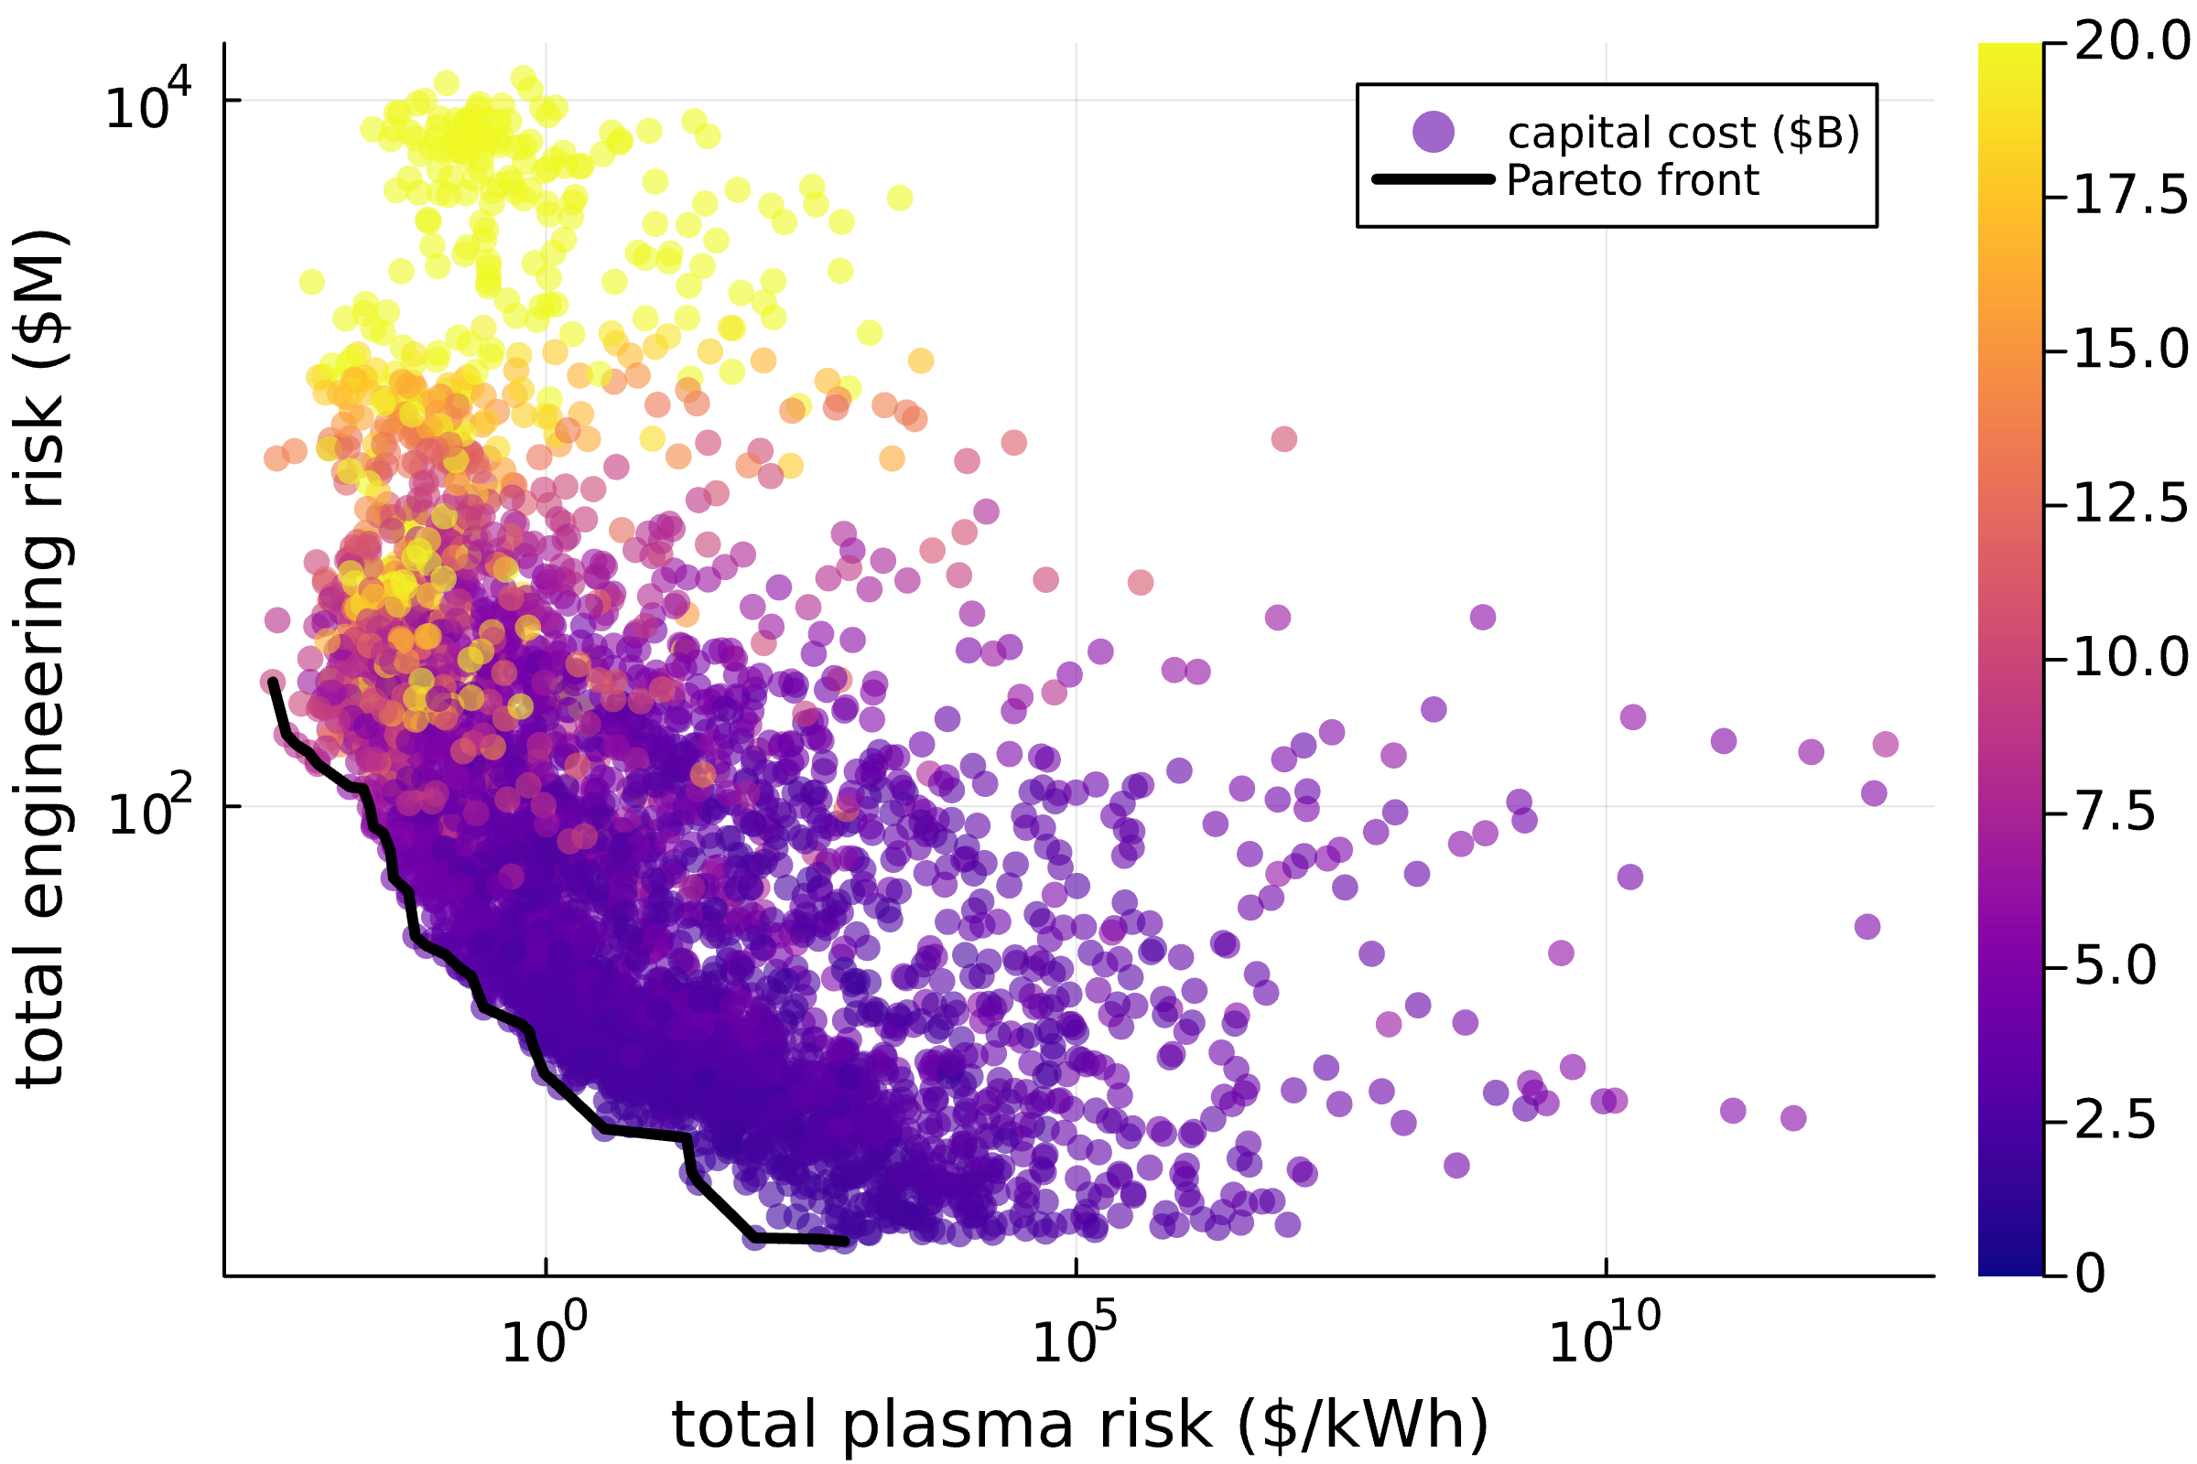
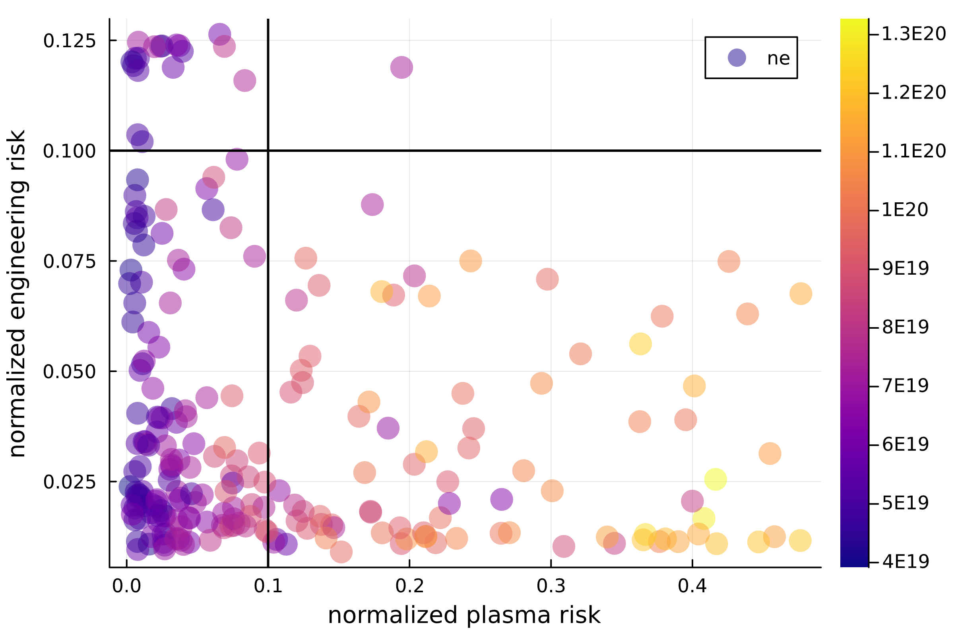
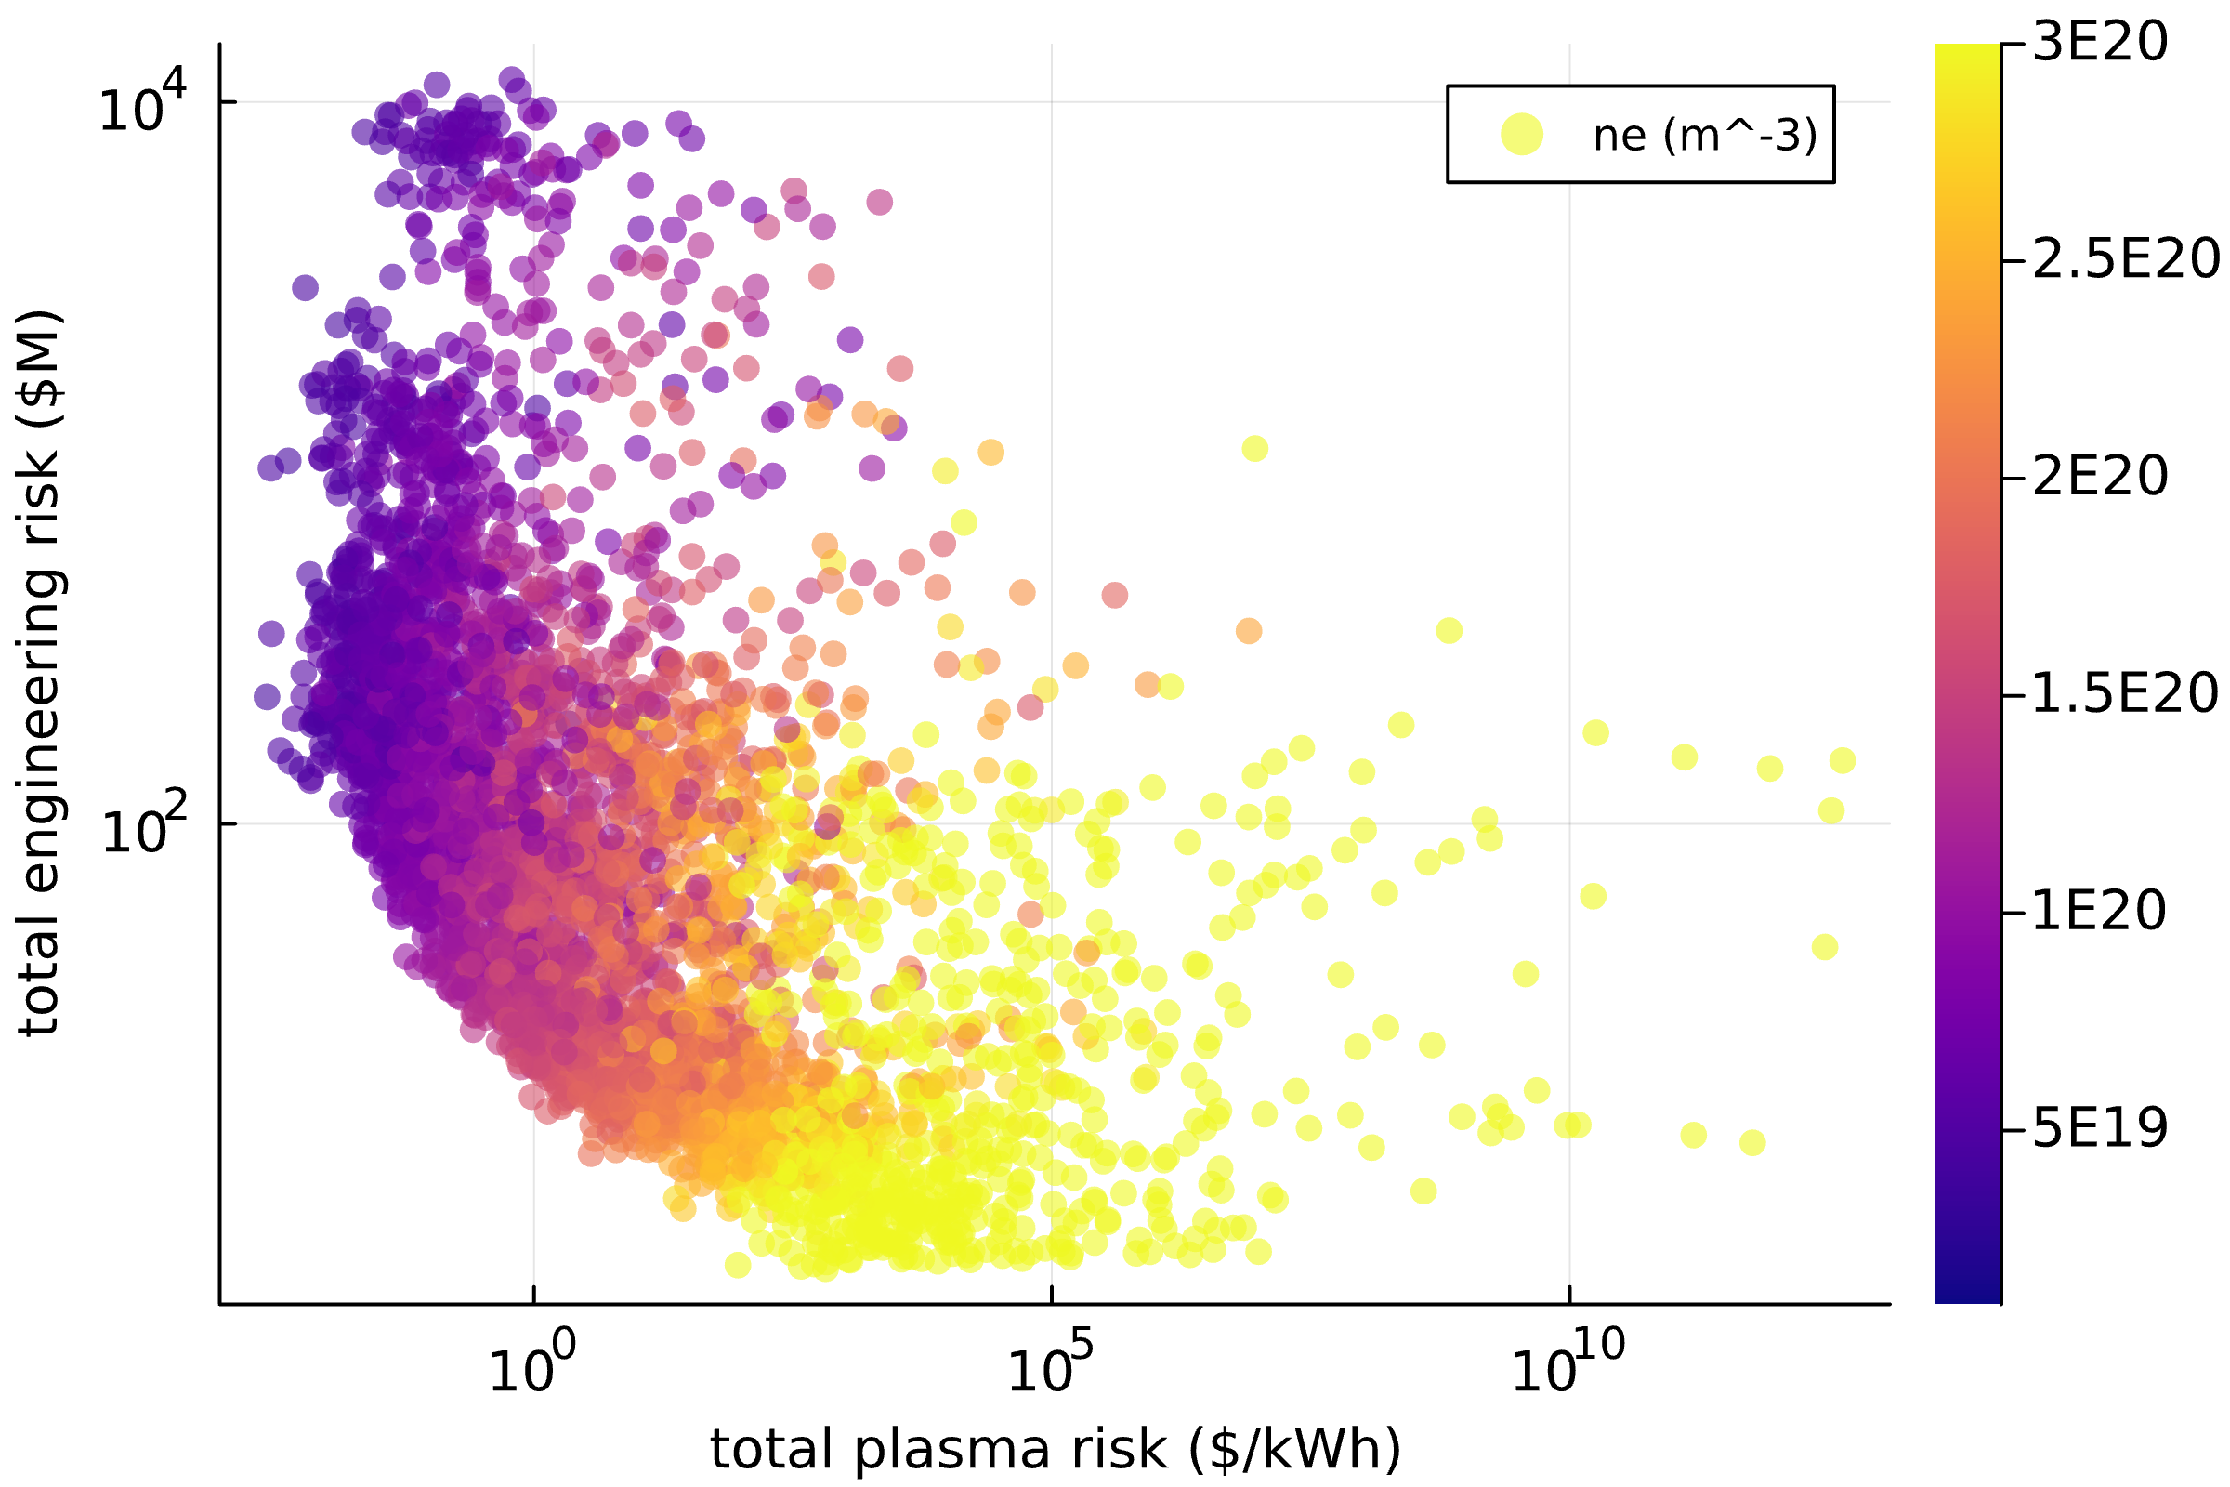


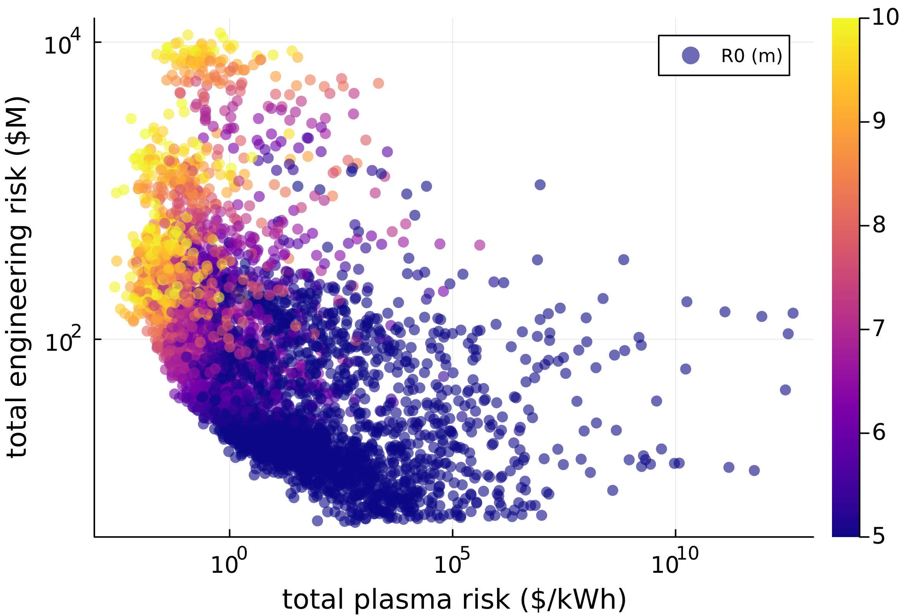
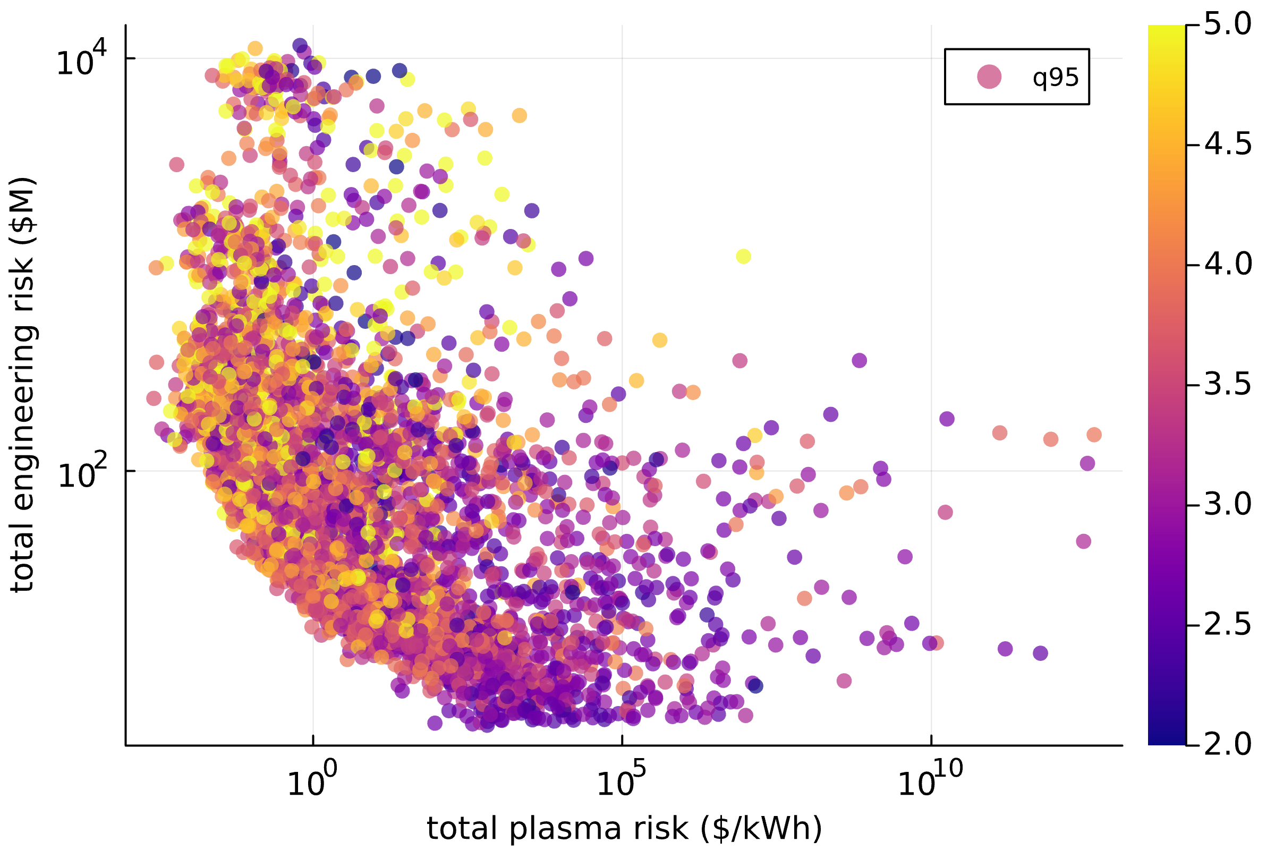
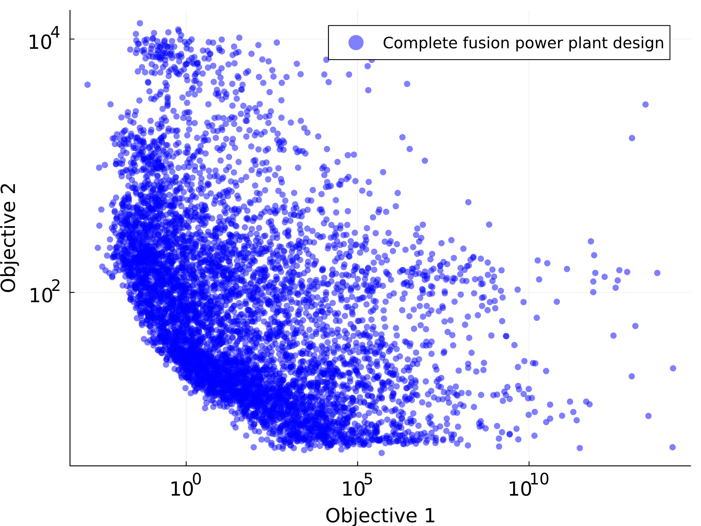
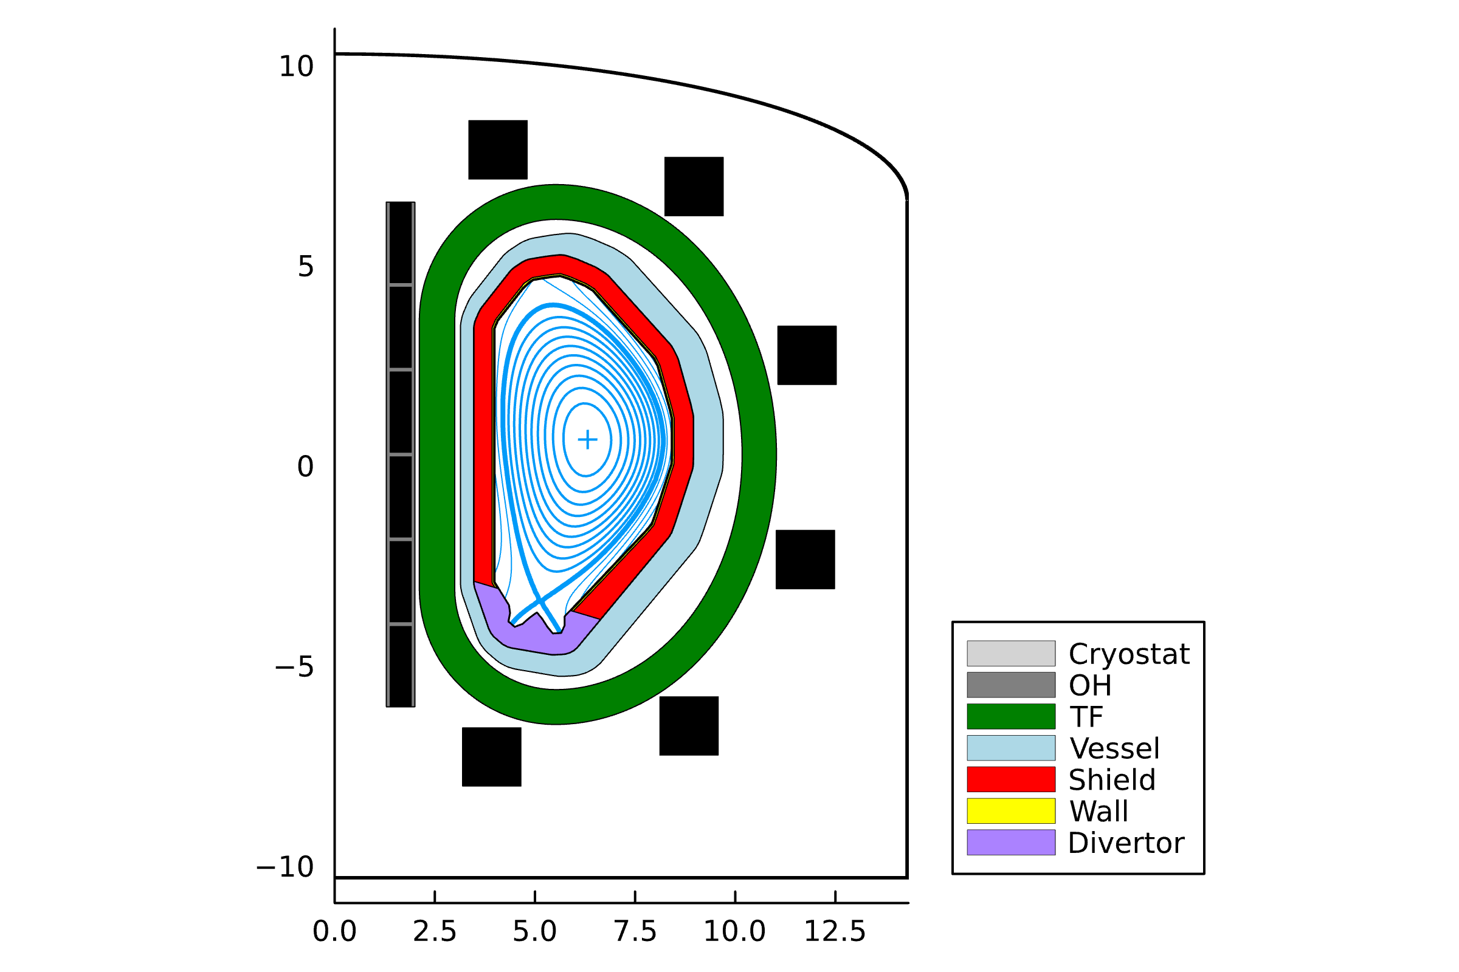
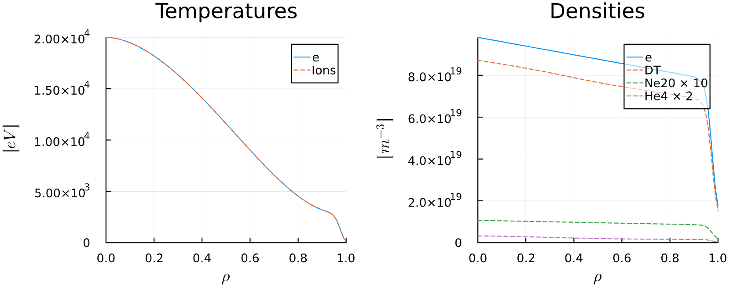
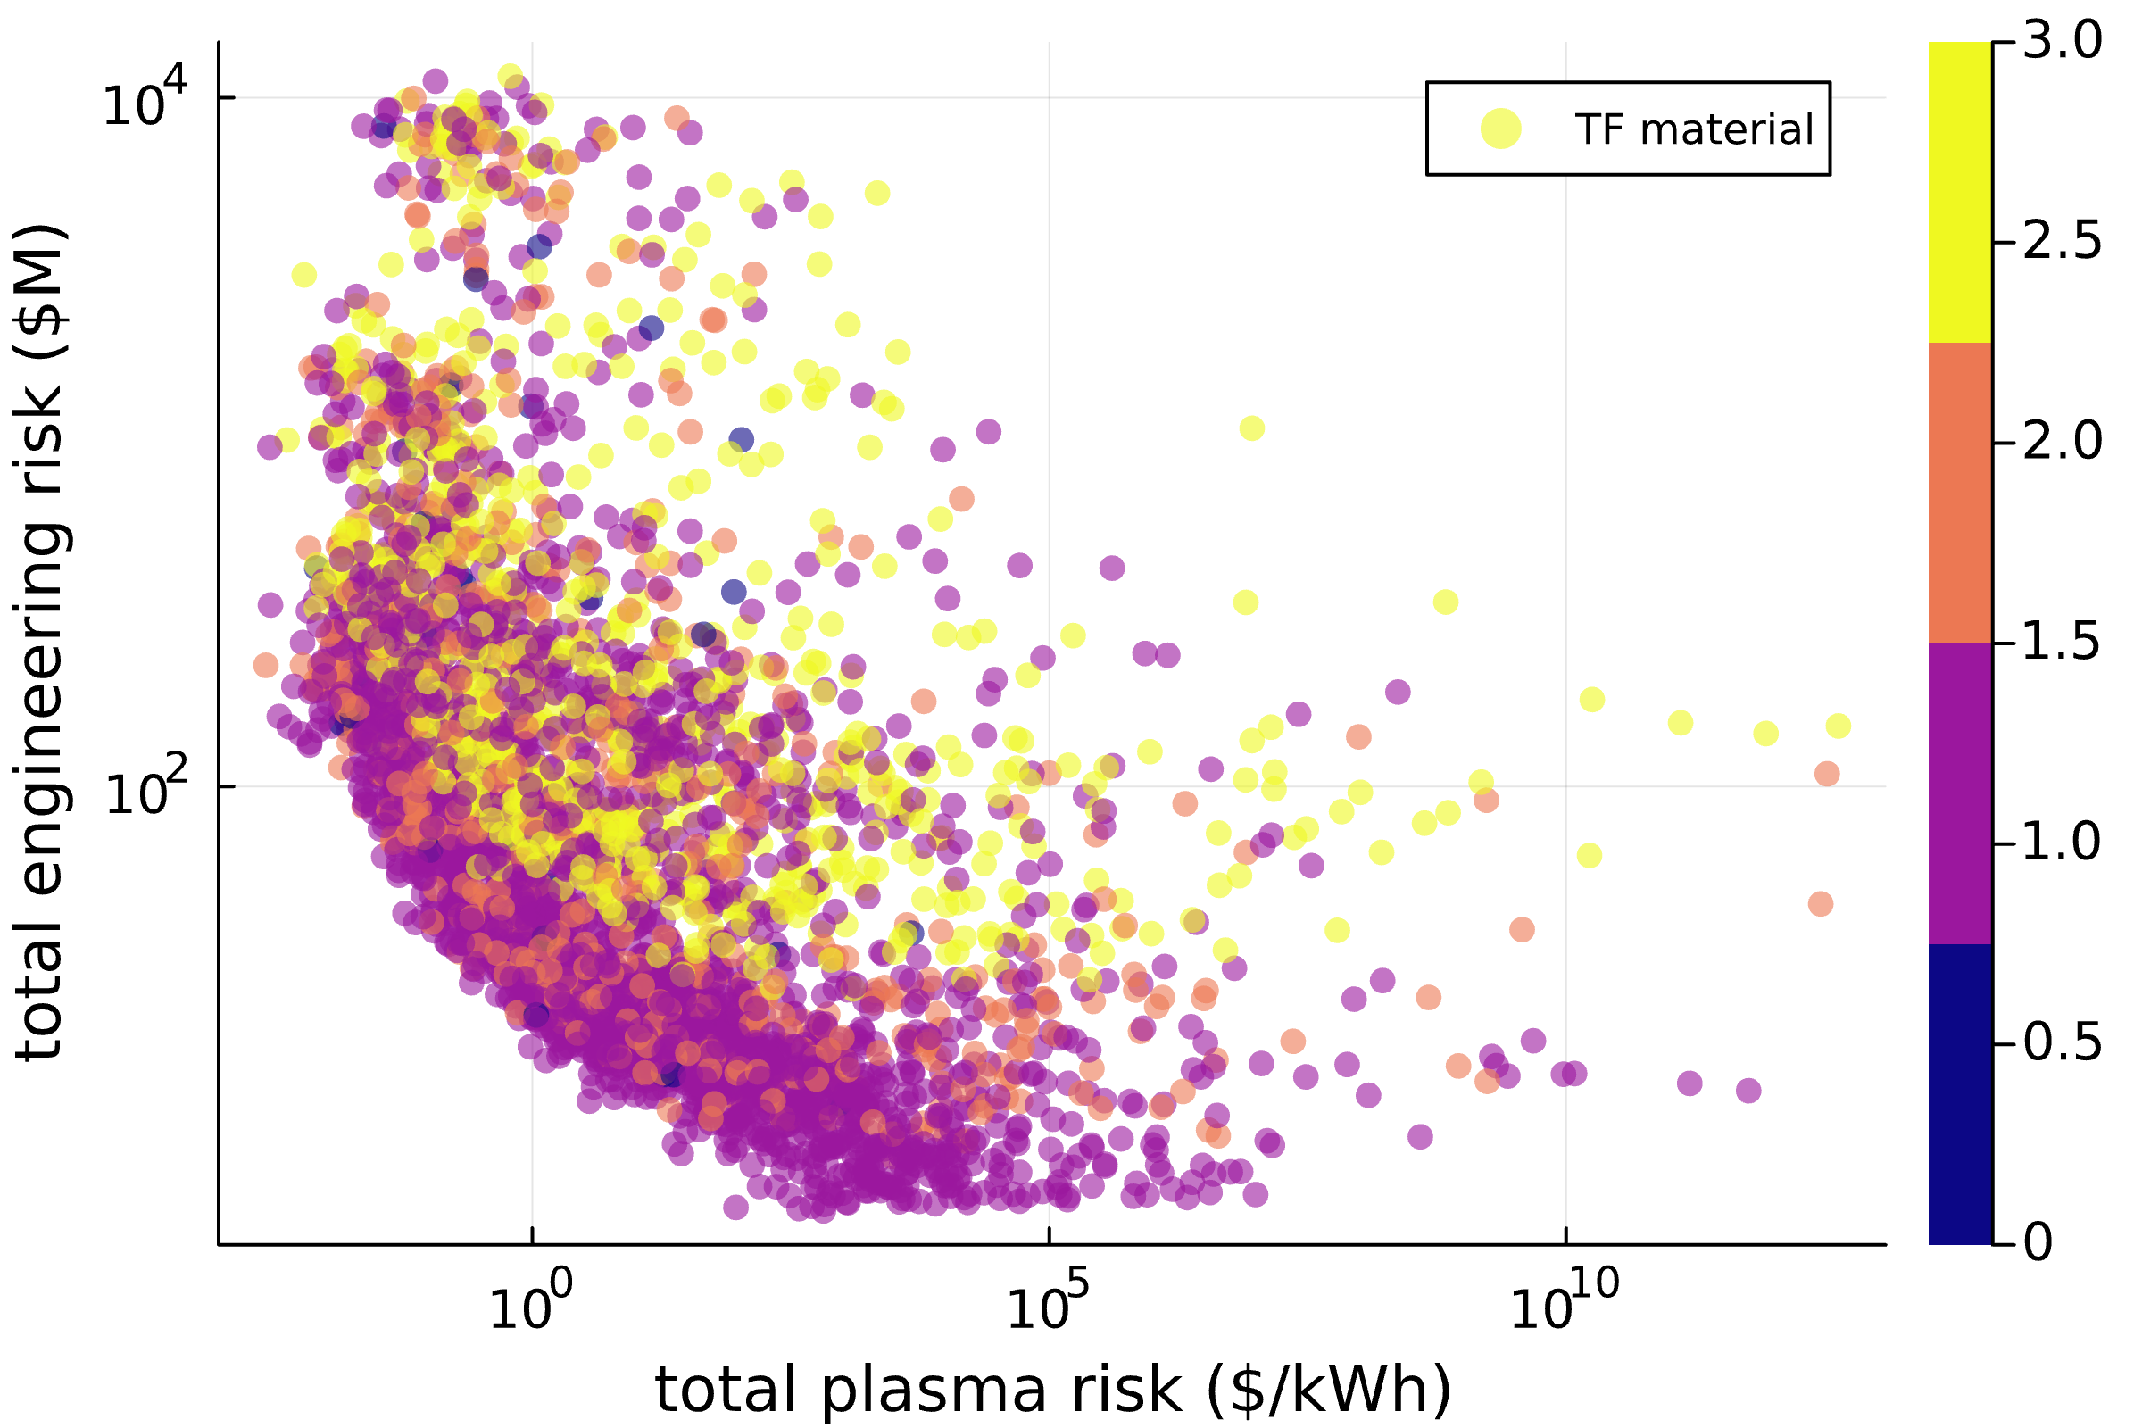
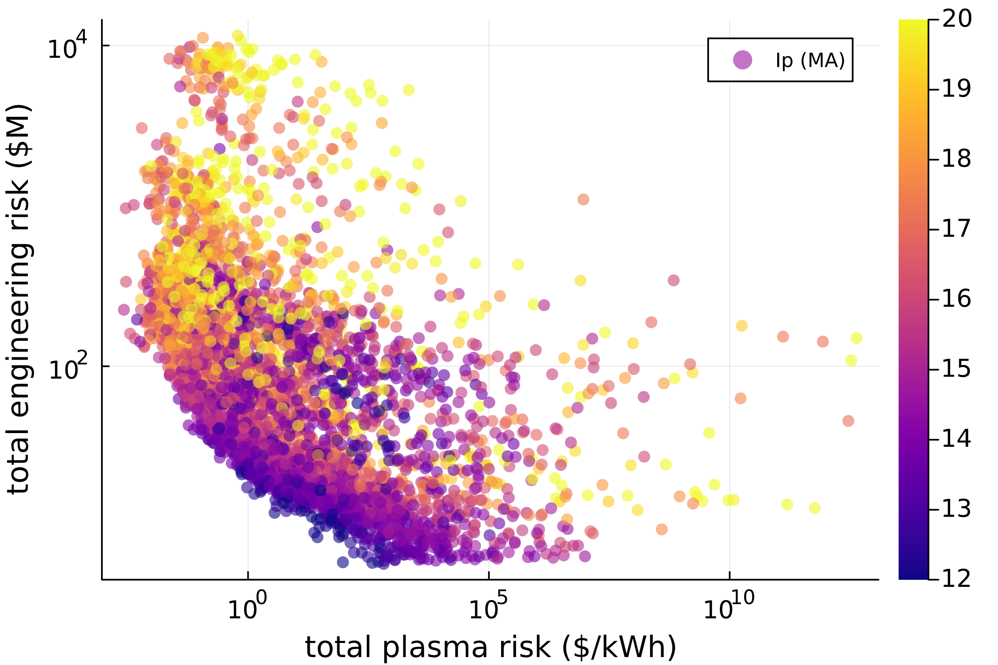
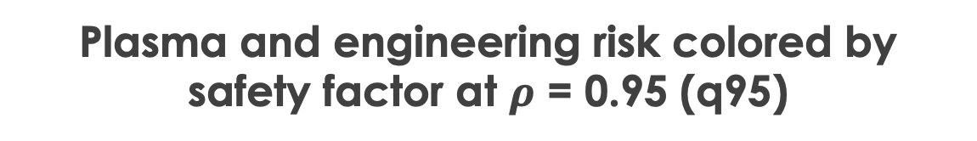
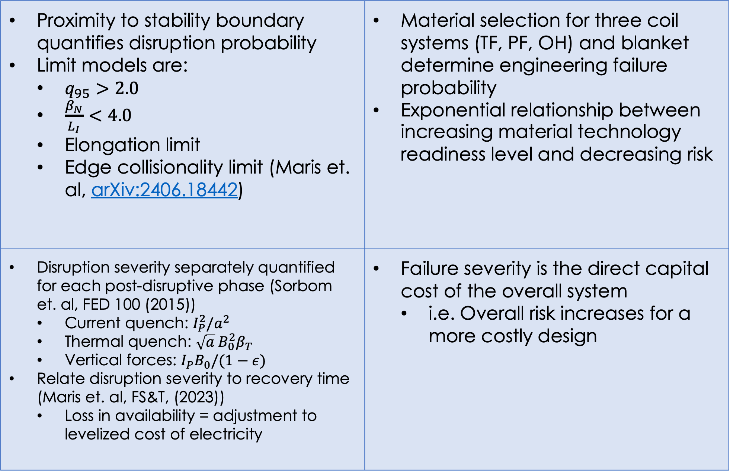
Risk minimization as a novel optimization objective in FUSE
A.G. Ghiozzi, O. Meneghini, T. Slendebroek, G. Avdeeva, T. Cote, G. Dose, B.A. Grierson, J. Guterl, J. Harvey, B.C. Lyons, J. McClenaghan, T.F. Neiser, N. Shi, D. Weisberg
What is the FUSE framework?
How does risk influence optimal design?
Recently open-sourced integrated modeling framework written in Julia
Capable of whole-facility simulations with models from core plasma and build to balance of plant and costing
Modular actor structure with data stored and passed via a single unifying data structure built around ITER IMAS ontology
Constrained multi-objective optimization enables design exploration and quantification of tradeoffs
Three objective optimization:
Minimize plasma risk (x-axis)
Minimize engineering risk (y-axis)
Minimize direct capital cost (color)
Constraints:
P_{electric, net} > 100 MW
TBR > 1.1
Flattop > 1 hour
Decreasing density reliably mitigates plasma risk
Plasma and engineering risk colored by line-averaged electron density (<ne>)
Plasma and engineering risk colored by device major radius (R0)
Plasma and engineering risk colored by safety factor at $ρ$ = 0.95 (q95)
Clusters of q95 extrema form in engineering-plasma risk space
Highest q95 values in the upper region of engineering risk
Lowest q95 values in the lower region of engineering risk
Scan to become a F(USER)
Scan to read more about FUSE
Direct tradeoff between size and risk type
At large R0, low plasma risk but high engineering risk
At small R0, high plasma risk but low engineering risk
What is multi-objective optimization?
Increasingly optimal solutions
Plasma and engineering risk colored by selected TF coil material
As solutions converge to form pareto front, plasma current goes down
High-Ip solutions are doubly penalized due to:
High disruption severity (plasma risk)
Low TRL for high critical current density superconducting materials (engineering risk)
Plasma and engineering risk colored by plasma current (Ip)
Pareto front: the set of solutions for which any improvement to one objective worsens the other objective
ReBCO
Along the Pareto front, most solutions use Nb3Sn ITER
Two clusters of solutions form – one dominated by Nb3Sn ITER, the other by ReBCO
ReBCO solutions are costly and therefore far from the Pareto front
Nb3Sn - KDEMO
How is risk modeled in FUSE?
Nb3Sn - ITER
Risk = probability of failure * severity of failure
Copper
Proximity to stability boundary quantifies disruption probability Limit models are: $q_{95}>2.0$ $\frac{β_{N}}{L_{I}}<4.0$ Elongation limit Edge collisionality limit (Maris et. al, arXiv:2406.18442) | Material selection for three coil systems (TF, PF, OH) and blanket determine engineering failure probability Exponential relationship between increasing material technology readiness level and decreasing risk
Disruption severity separately quantified for each post-disruptive phase (Sorbom et. al, FED 100 (2015)) Current quench: $I_{P}^{2}/a^{2}$ Thermal quench: $\sqrt{a} B_{0}^{2}β_{T}$ Vertical forces: $I_{P}B_{0}/(1−ε)$ Relate disruption severity to recovery time (Maris et. al, FS&T, (2023)) Loss in availability = adjustment to levelized cost of electricity | Failure severity is the direct capital cost of the overall system i.e. Overall risk increases for a more costly design
Why risk as an optimization objective?
Conclusions and future work
Probability
Third objective: Design it to operate stably
(= minimize plasma risk)
There are inherent tradeoffs between minimization of plasma and engineering risks
Pareto front is steep when both plasma and engineering risk are minimized – improvements to one objective cost you significantly in the other
Possible extensions include:
New stability limits to quantify plasma risk in negative triangularity
Surrogate model for mode locking probability
Effect of constructing spare parts on engineering risk
First objective: Build a device that makes power
Unintended consequenceHigh cost
Second objective: Build it within a realistic budget (= minimize cost)
Unintended consequenceHigh risk
Fourth objective: Build it out of proven technologies
(= minimize engineering risk)
Severity
Acknowledgments
Mitigating cost and risk helps us create designs that are grounded in reality
The author would like to thank A. Maris for insightful discussions
Plasma
Engineering

